Slide 1
Chapter 17
Linked Lists

Slide 2
Objectives (1 of 2)
In this chapter, you will:
Learn about linked lists
Become familiar with the basic properties of linked lists
Explore the insertion and deletion operations on linked lists
Discover how to build and manipulate a linked list
Learn how to implement linked lists as ADTs

Slide 3
Objectives (2 of 2)
Learn how to create linked list iterators
Learn how to implement the basic operations on a linked list
Learn how to create unordered linked lists
Learn how to create ordered linked lists
Learn how to construct a
Become familiar with circular linked lists doubly linked list

Slide 4
Introduction
Data can be organized and processed sequentially using an array, called a sequential list
Problems with an array
Array size is fixed
Unsorted array: searching for an item is slow
Sorted array: insertion and deletion is slow because it requires data movement

Slide 5

Linked Lists (1 of 3)
Linked list: a collection of items (nodes) containing two components:
Data
Address (link) of the next node in the list
FIGURE 17-1 Structure of a node

Slide 6
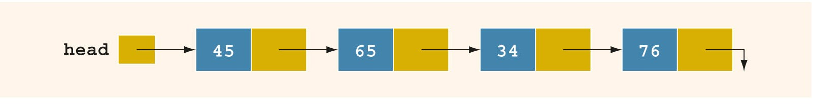
Linked Lists (2 of 3)
FIGURE 17-2 Linked list

Slide 7
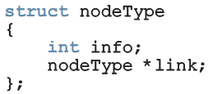
Linked Lists (3 of 3)
A node is declared as a class or struct
Data type of a node depends on the specific application
Link component of each node is a pointer
Variable declaration:

Slide 8
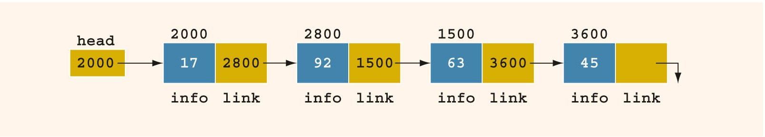
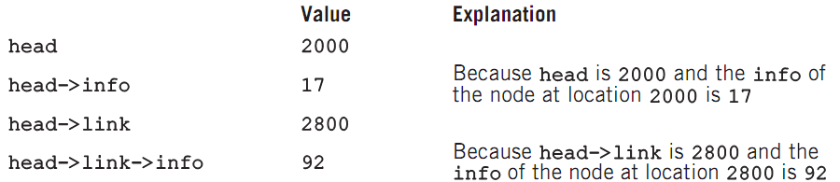
Linked Lists: Some Properties (1 of 3)
Example: linked list with four nodes (Figure 17-4)

Slide 9
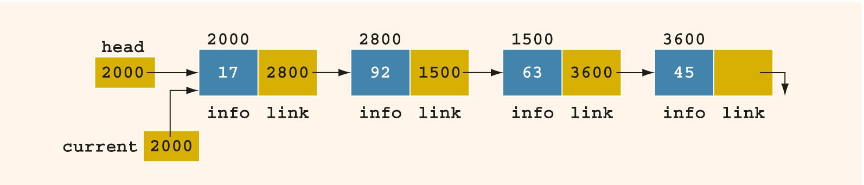
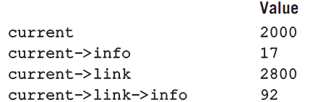
Linked Lists: Some Properties (2 of 3)
current = head;
Copies value of head into current
FIGURE 17-5 Linked list after the statement current = head; executes

Slide 10
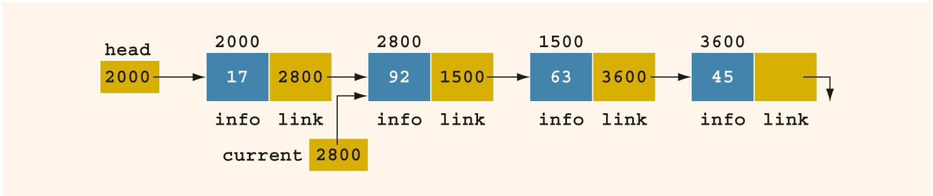
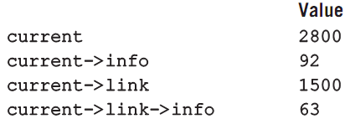
Linked Lists: Some Properties (3 of 3)
current = current->link;
FIGURE 17-6 List after the statement current = current->link; executes

Slide 11
Traversing a Linked List (1 of 2)
Basic operations of a linked list:
Search for an item in the list
Insert an item in the list
Delete an item from the list
Traversal: given a pointer to the first node of the list, step through the nodes of the list

Slide 12
Traversing a Linked List (2 of 2)
To traverse a linked list:
Example:
current = head;
while (current != nullptr)
{
//Process the current node
current = current->link;
}
current = head;
while (current != nullptr)
{
cout << current->info << " ";
current = current->link;
}

Slide 13
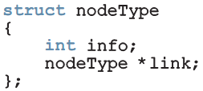
Item Insertion and Deletion
Definition of a node:
Variable declaration:

Slide 14

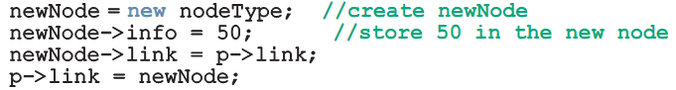
Insertion (1 of 4)
To insert a new node with info 50 after p in this list:
FIGURE 17-7 Linked list before item insertion

Slide 15
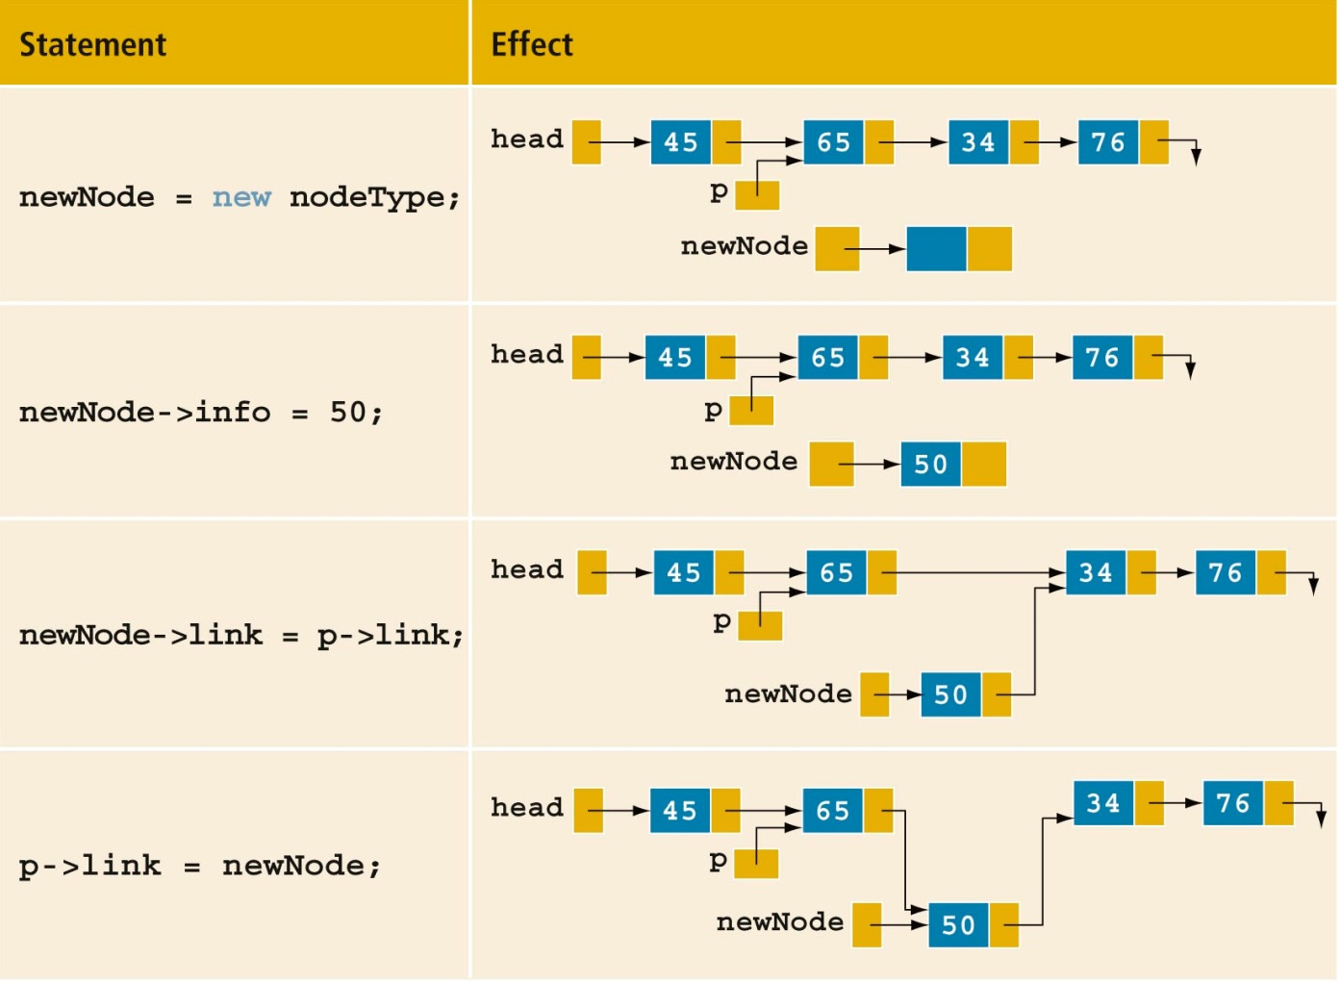
Insertion (2 of 4)
TABLE 17-1 Inserting a Node in a Linked List

Slide 16

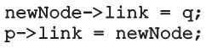
Insertion (3 of 4)
Can use two pointers to simplify the insertion code somewhat:
FIGURE 17-9 List with pointers p and q
To insert newNode between p and q:

Slide 17
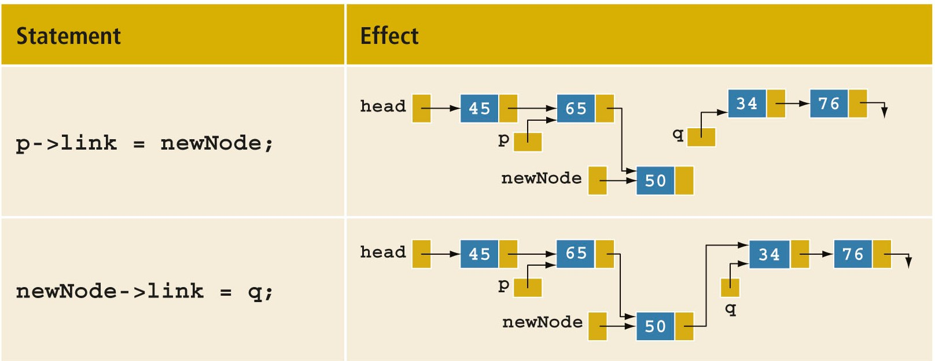
Insertion (4 of 4)
TABLE 17-2 Inserting a Node in a Linked List Using Two Pointers

Slide 18


Deletion (1 of 3)
Node with info 34 is to be deleted:
FIGURE 17-10 Node to be deleted is with info 34
FIGURE 17-11 List after the statement newNode->link = q; executes

Slide 19
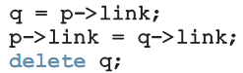
Deletion (2 of 3)
Node with info 34 is removed from the list, but memory is still occupied
Node is dangling
Must keep a pointer to the node to be able to deallocate its memory

Slide 20
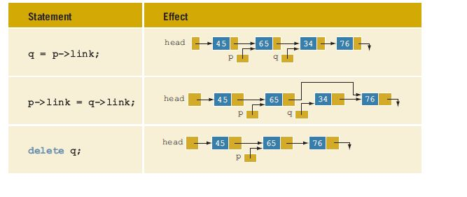
Deletion (3 of 3)
TABLE 17-3 Deleting a Node from a Linked List

Slide 21
Building a Linked List
If data is unsorted, the list will be unsorted
Can build a linked list forward or backward
Forward: a new node is always inserted at the end of the linked list
Backward: a new node is always inserted at the beginning of the list

Slide 22
Building a Linked List Forward (1 of 4)
Need three pointers to build the list:
One to point to the first node in the list, which cannot be moved
One to point to the last node in the list
One to create the new node
Example:
Data: 2 15 8 24 34

Slide 23


Building a Linked List Forward (2 of 4)
FIGURE 17-12 Empty list
FIGURE 17-14 List after inserting newNode in it

Slide 24
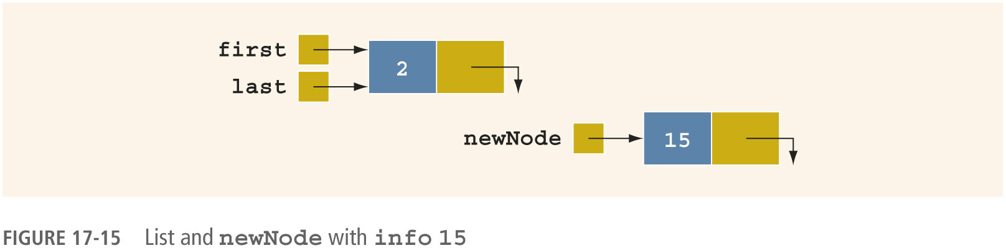

Building a Linked List Forward (3 of 4)
FIGURE 17-15 List and newNode with info 15
FIGURE 17-16 List after inserting newNode at the end

Slide 25
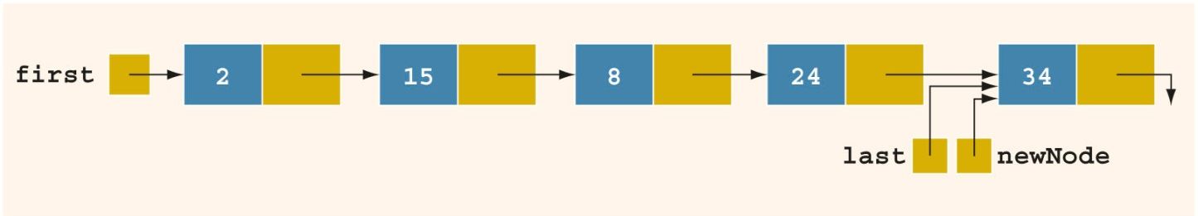
Building a Linked List Forward (4 of 4)
Now repeat this process three more times:
FIGURE 17-17 List after inserting 8, 24, and 34

Slide 26
Building a Linked List Backward
Algorithm to build a linked list backward:
Initialize first to nullptr
For each item in the list
Create the new node, newNode
Store the data in newNode
Insert newNode before first
Update the value of the pointer first

Slide 27
Linked List as an ADT (1 of 4)
Basic operations on linked lists:
Initialize the list
Determine whether the list is empty
Print the list
Find the length of the list
Destroy the list
Retrieve info contained in the first or last node
Search the list for a given item

Slide 28
Linked List as an ADT (2 of 4)
Basic operations on linked lists (cont’d.):
Insert an item in the list
Delete an item from the list
Make a copy of the linked list

Slide 29
Linked List as an ADT (3 of 4)
Two general types of linked lists:
Sorted and unsorted lists
Algorithms to implement the operations search, insert, and remove differ slightly for sorted and unsorted lists
abstract class linkedListType will implement basic linked list operations
Derived classes: unorderedLinkedList and orderedLinkedList

Slide 30
Linked List as an ADT (4 of 4)
For an unordered linked list, can insert a new item at either the end or the beginning
buildListForward inserts item at the end
buildListBackward inserts item at beginning
Will need two functions:
insertFirst and insertLast
Will use two pointers in the list:
first and last

Slide 31
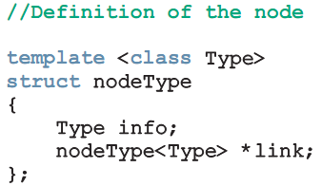
Structure of Linked List Nodes
Each node has two member variables
We implement the node of a linked list as a struct
Definition of the struct nodeType:

Slide 32
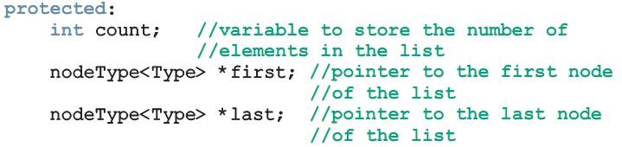
Member Variables of the class linkedListType
linkedListType has three member variables:
Two pointers: first and last
count: the number of nodes in the list

Slide 33
Linked List Iterators (1 of 4)
To process each node of the list
List must be traversed, starting at first node
Iterator: object that produces each element of a container, one element at a time
The two most common iterator operations:
++ (the increment operator)
* (the dereferencing operator)

Slide 34
Linked List Iterators (2 of 4)
An iterator is an object
Need to define a class (linkedListIterator) to create iterators to objects of the class linkedListType
Will have one member variable to refer to the current node

Slide 35
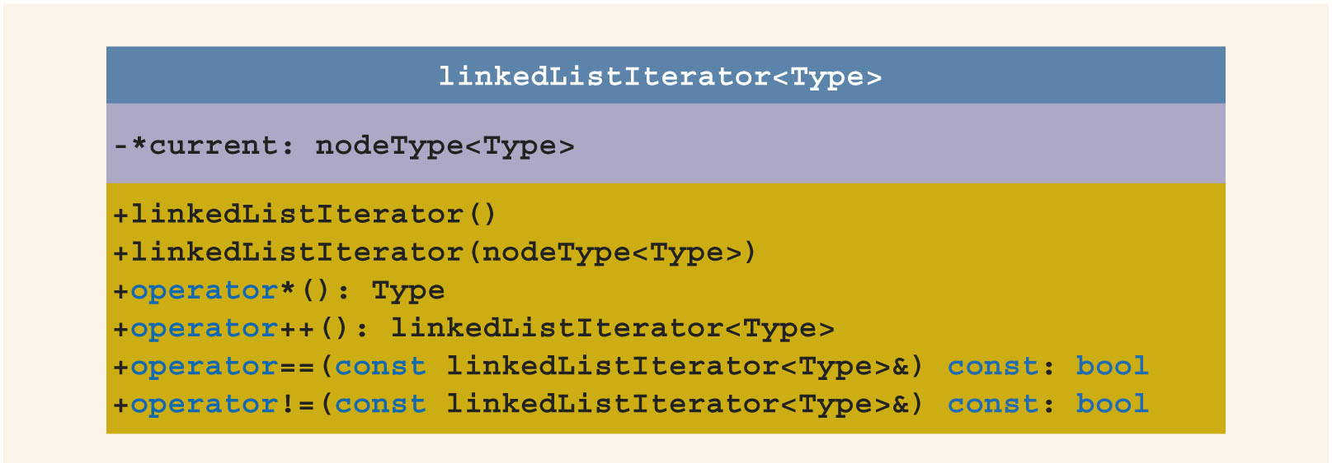
Linked List Iterators (3 of 4)
FIGURE 17-19 UML class diagram of the class linkedListIterator

Slide 36
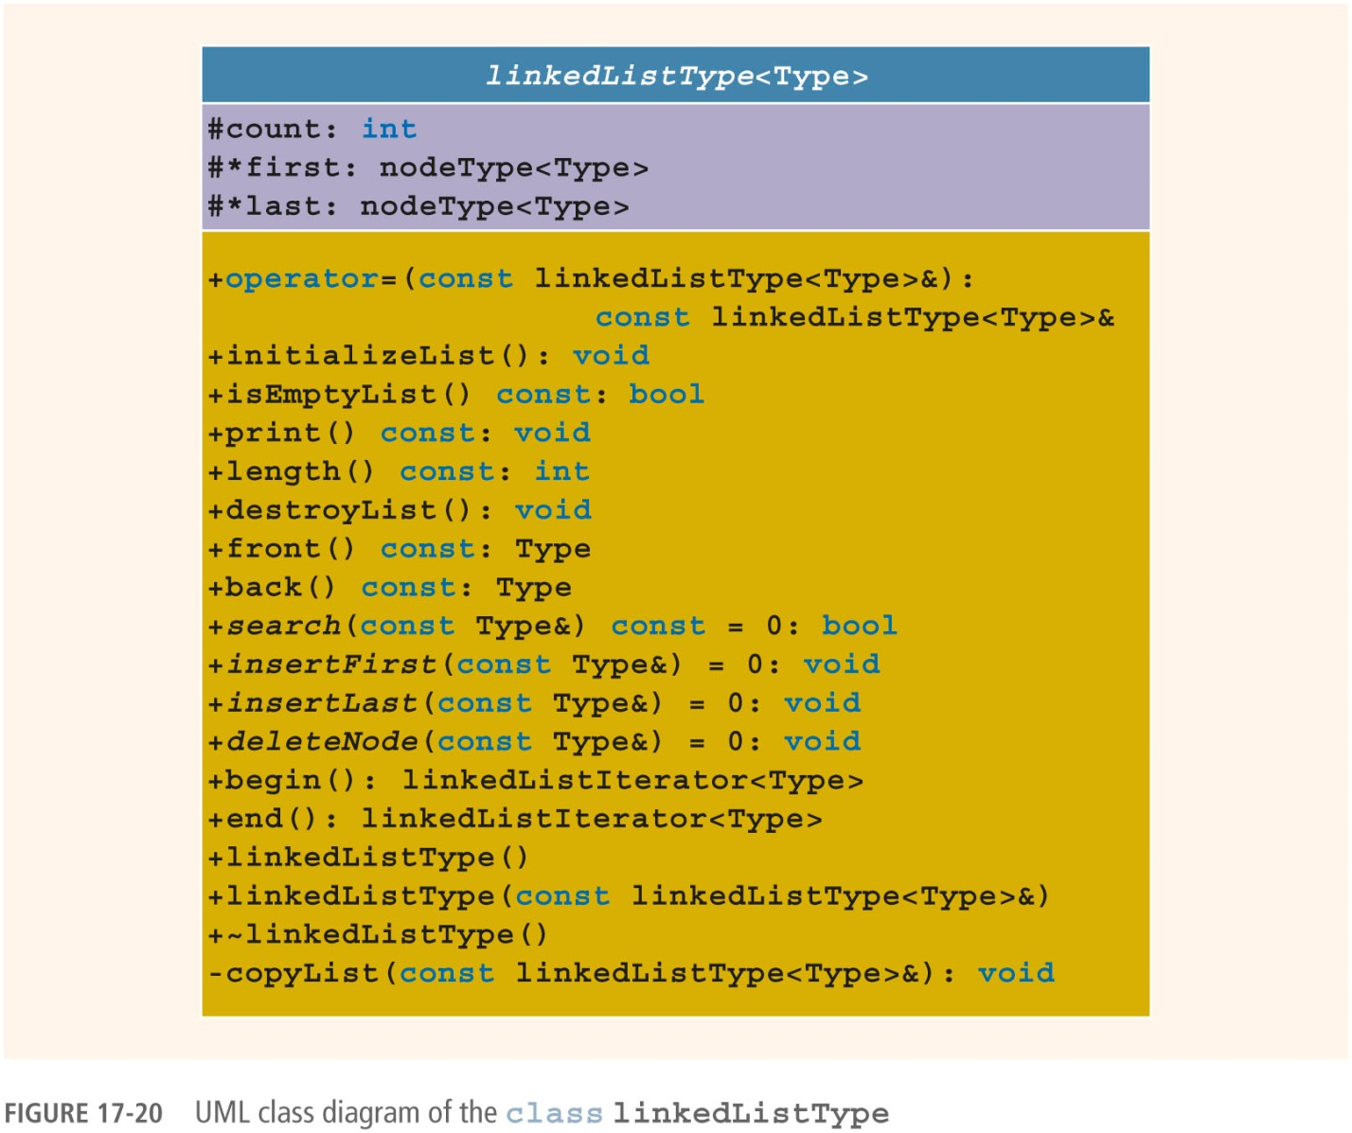
Linked List Iterators (4 of 4)
FIGURE 17-20 UML class diagram of the class linkedListType

Slide 37
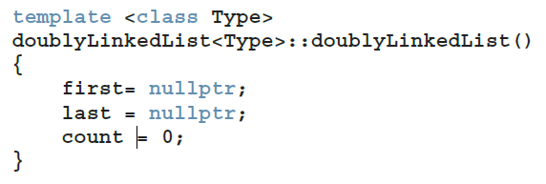
Default Constructor
Default constructor:
Initializes the list to an empty state

Slide 38
Destroy the List
Function destroyList:
Traverses the list to deallocate memory occupied by each node
Once list is destroyed, sets pointers first and last to nullptr and count to 0

Slide 39
Initialize the List
Function initializeList:
Initializes list to an empty state
Since constructor already did this, initializeList is used to reinitialize an existing list

Slide 40
Print the List
Function print:
Prints data contained in each node
Traverses the list using another pointer

Slide 41
Length of a List
Function length:
Returns the count of nodes in the list
Uses the count variable

Slide 42
Retrieve the Data of the First or Last Node
Function front:
Returns the info contained in the first node
If list is empty, program will be terminated
Function back:
Returns the info contained in the last node
If list is empty, program will be terminated

Slide 43
Begin and End
Function begin:
Returns an iterator to the first node in the list
Function end:
Returns an iterator to one past the last node in the list

Slide 44
Copy the List
Function copyList:
Makes an identical copy of a linked list
Steps:
Create a node called newNode
Copy the info of the original node into newNode
Insert newNode at the end of the list being created

Slide 45
Destructor & Copy Constructor
Destructor:
Deallocates memory occupied by nodes when the class object goes out of scope
Calls destroyList to traverse the list and delete each node
Copy constructor:
Makes an identical copy of the linked list
Calls function copyList

Slide 46
Overloading the Assignment Operator
Definition of the function to overload the assignment operator
Similar to the copy constructor

Slide 47
Unordered Linked Lists (1 of 2)
class unorderedLinkedList
Derived from the abstract class linkedListType
Implements the operations search, insertFirst, insertLast, and deleteNode

Slide 48
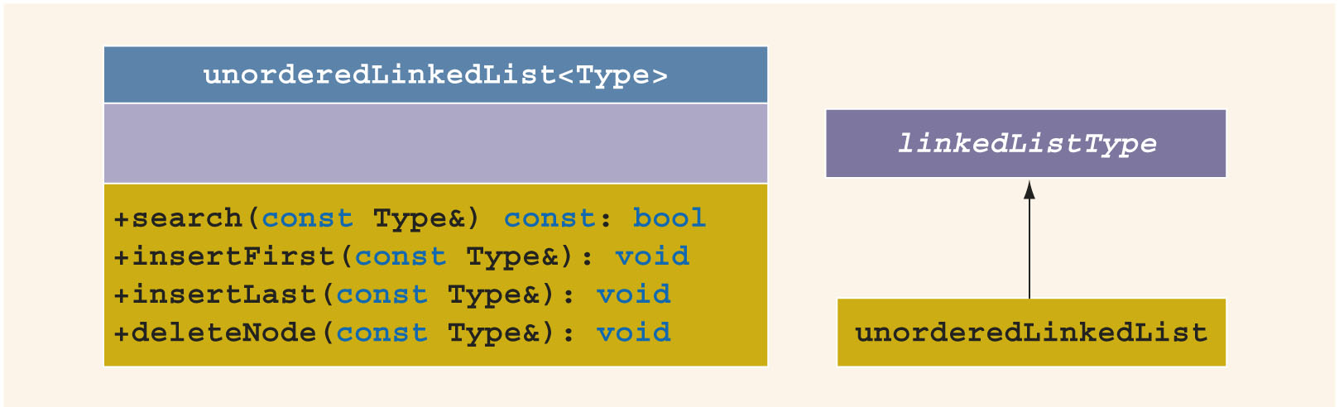
Unordered Linked Lists (2 of 2)
FIGURE 17-19 UML class diagram of the class linkedListIterator

Slide 49
Unordered Linked List: Search the List
Function search:
Searches the list for a given item
Steps:
Compare search item with current node in the list
If info of current node is the same as search item, stop the search
Otherwise, make the next node the current node
Repeat Step 1 until item is found or until no more data is left in the list

Slide 50
Insert the First Node
Function insertFirst:
Inserts a new item at the beginning of the list
Steps:
Create a new node
Store the new item in the new node
Insert the node before first
Increment count by 1

Slide 51
Insert the Last Node
Function insertLast:
Inserts a new node after last
Similar to insertFirst function

Slide 52
Delete a Node (1 of 6)
Function deleteNode:
Deletes a node with given info from the list
Several possible cases to manage
Case 1: List is empty
If the list is empty, output an error message
Case 2: Node to be deleted is the first node
Adjust the pointer first and count
If no other nodes, set first and last to nullptr

Slide 53
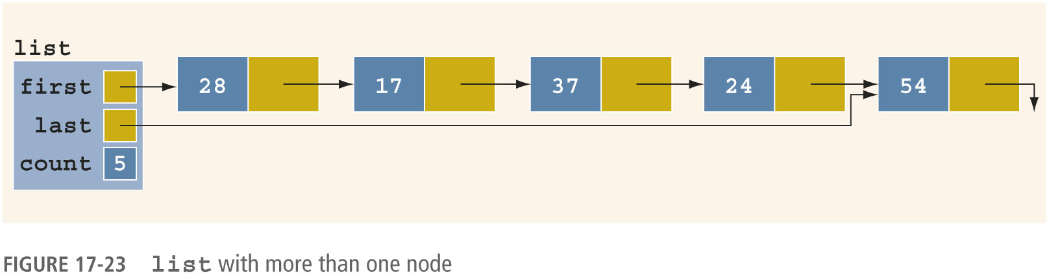
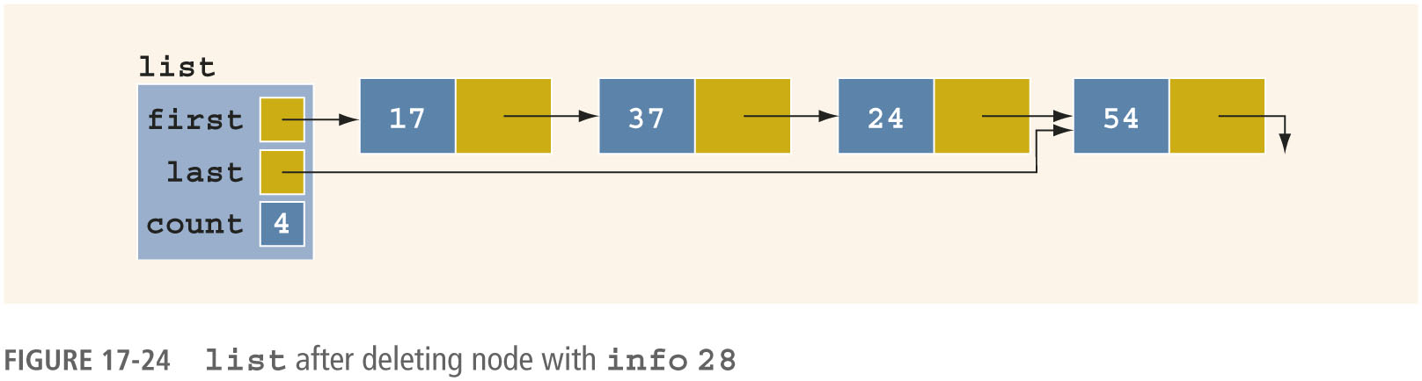
Delete a Node (2 of 6)
FIGURE 17-23 list with more than one node
FIGURE 17-24 list after deleting node with info 28

Slide 54
Delete a Node (3 of 6)
Case 3: Node to be deleted is not the first one
Case 3a: Node to be deleted is not last one
Update link field of the previous node
Case 3b: Node to be deleted is the last node
Update link field of the previous node to nullptr
Update last pointer to point to previous node

Slide 55
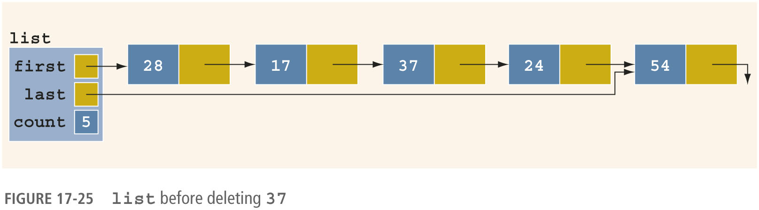
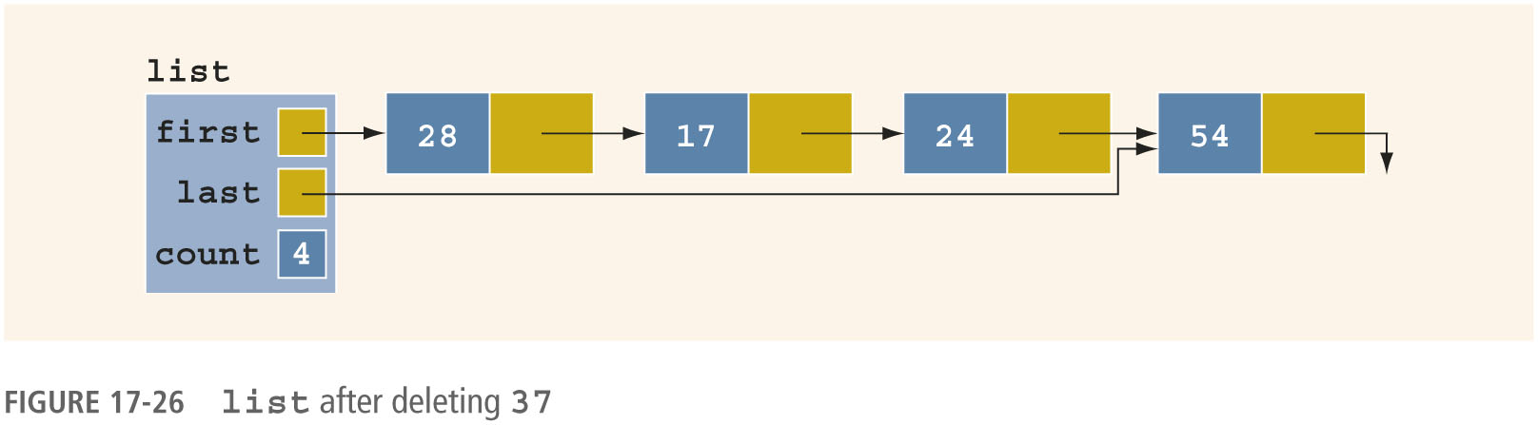
Delete a Node (4 of 6)
FIGURE 17-25 list before deleting 37
FIGURE 17-26 list after deleting 37

Slide 56
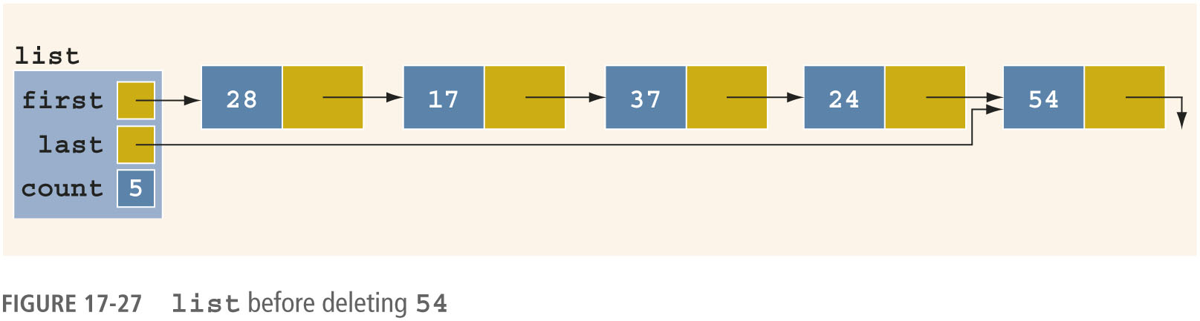
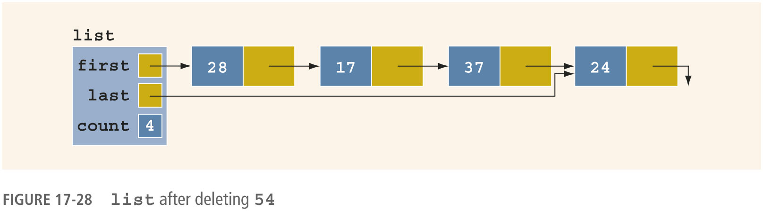
Delete a Node (5 of 6)
FIGURE 17-27 list before deleting 54
FIGURE 17-28 list after deleting 54

Slide 57
Delete a Node (6 of 6)
Case 4: Node to be deleted is not in the list
List requires no adjustment
Simply output an error message

Slide 58
Ordered Linked Lists (1 of 2)
orderedLinkedList: derived from class linkedListType
Provides definitions of the abstract functions insertFirst, insertLast, search, and deleteNode
Assume that elements of an ordered linked list are arranged in ascending order
Include the function insert to insert an element in an ordered list at its proper place

Slide 59
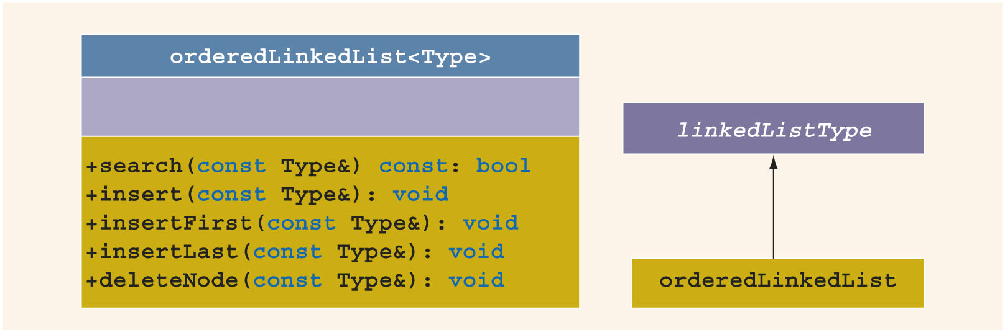
Ordered Linked Lists (2 of 2)
FIGURE 17-29 UML class diagram of the class orderedLinkedList and the inheritance hierarchy

Slide 60
Ordered Linked Lists: Search the List
Steps:
Compare the search item with the current node in the list
If info of current node is >= to search item, stop search
Otherwise, make the next node the current node
Repeat Step 1 until an item in the list >= to search item is found, or no more data is left in the list

Slide 61
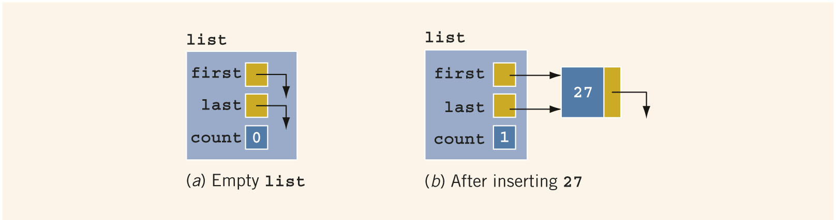
Insert a Node (1 of 5)
Case 1: The list is empty
New node becomes first node
FIGURE 17-30 list

Slide 62
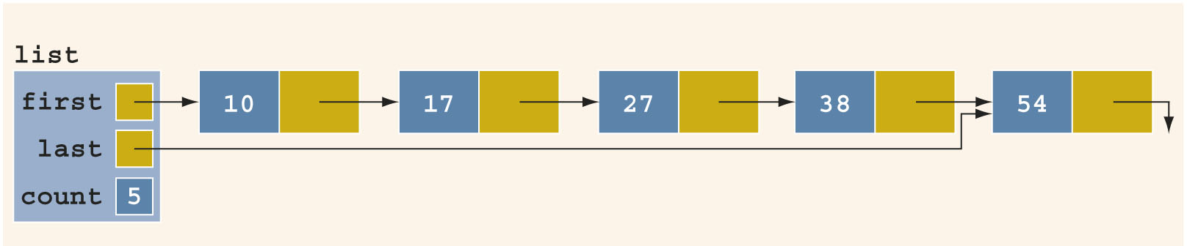
Insert a Node (2 of 5)
Case 2: List is not empty, and the item to be inserted is smaller than smallest item in list
New node goes at beginning of list
FIGURE 17-32 list after inserting 10

Slide 63
Insert a Node (3 of 5)
Case 3: New item to be inserted somewhere in list
Case 3a: New item is larger than largest item
New item is inserted at end of list
Case 3b: Item to be inserted goes somewhere in the middle of the list

Slide 64
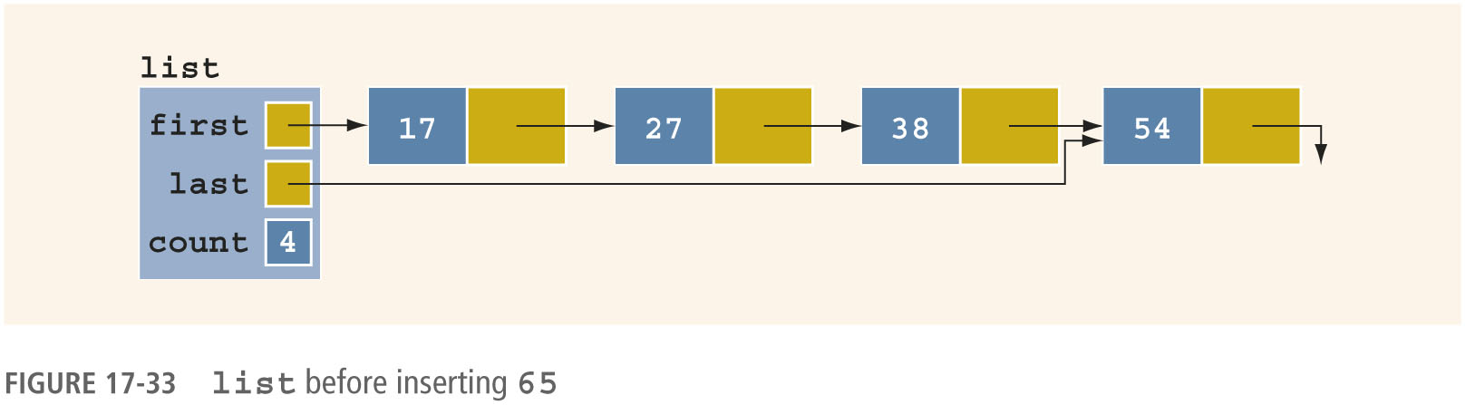

Insert a Node (4 of 5)
FIGURE 17-33 list before inserting 65
FIGURE 17-34 list after inserting 65

Slide 65


Insert a Node (5 of 5)
FIGURE 17-35 list before inserting 27
FIGURE 17-36 list after inserting 27

Slide 66
Insert First and Insert Last
Functions insertFirst and insertLast
Must insert new item at the proper place to ensure resulting list is still sorted
These functions are not actually used
Definitions must be provided because they are declared as abstract in the parent class
Function insertNode is used to insert at the proper place

Slide 67
Delete a Node
Case 1: List is initially empty → error
Case 2: Item to be deleted is first node in list
Adjust the head (first) pointer
Case 3: Item is somewhere in the list
current points to node with item to delete
trailCurrent points to node previous to the one pointed to by current
Case 4: Item is not in the list →error

Slide 68
Print a Linked List in Reverse Order (Recursion Revisited)
Links are only in forward direction
Cannot traverse list backward using links
Can use recursion
List is printed only if pointer to the list is not nullptr
Recursive call is on the tail of the list
When tail is empty, recursion stops

Slide 69
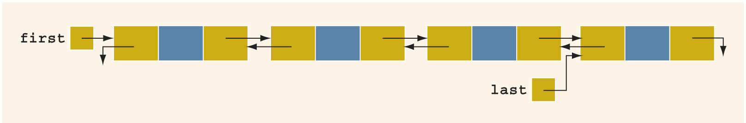
Doubly Linked Lists (1 of 2)
Doubly linked list: every node has next and back pointers
Can be traversed in either direction
FIGURE 17-39 Doubly linked list

Slide 70
Doubly Linked Lists (2 of 2)
Operations:
Initialize or destroy the list
Determine whether the list is empty
Search the list for a given item
Retrieve the first or last element of the list
Insert or delete an item
Find the length of the list
Print the list
Make a copy of the list

Slide 71
Doubly Linked List: Default Constructor
Default constructor:
Initializes doubly-linked list to empty state
Sets first and last to nullptr, and count to 0
isEmptyList:
Returns true if list is empty, false otherwise

Slide 72
Destroy the List & Initialize the List
Function destroy:
Deletes all the nodes in the list, leaving list in an empty state
Sets count to 0
Function initializeList:
Reinitializes doubly linked list to an empty state
Uses the destroy operation

Slide 73
Length of the List & Print the List
Function length
Returns the count of nodes in the list
Function print
Traverses the list
Outputs the info contained in each node
Function reversePrint
Traverses list in reverse order using back links
Outputs the info in each node

Slide 74
Doubly Linked List: Search the List
Function search:
Returns true if search item is found, otherwise false
Algorithm is same as that for an ordered linked list

Slide 75
First and Last Elements
Function front
Returns first element of the list
Function back
Returns last element of the list
If list is empty, both functions will terminate the program

Slide 76
Insert a Node (1 of 2)
Four insertion cases:
Case 1: Insertion in an empty list
Case 2: Insertion at beginning of a nonempty list
Case 3: Insertion at end of a nonempty list
Case 4: Insertion somewhere in nonempty list
Cases 1 & 2 require update to pointer first
Cases 3 & 4 are similar:
After inserting item, increment count by 1

Slide 77
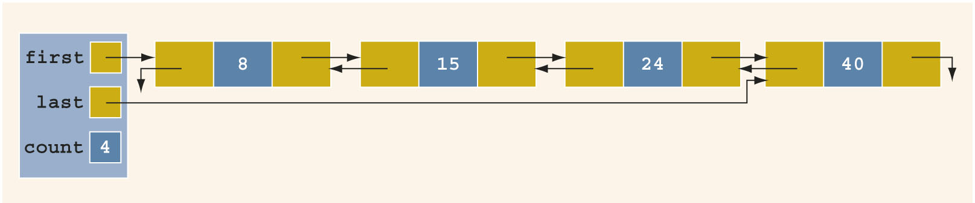
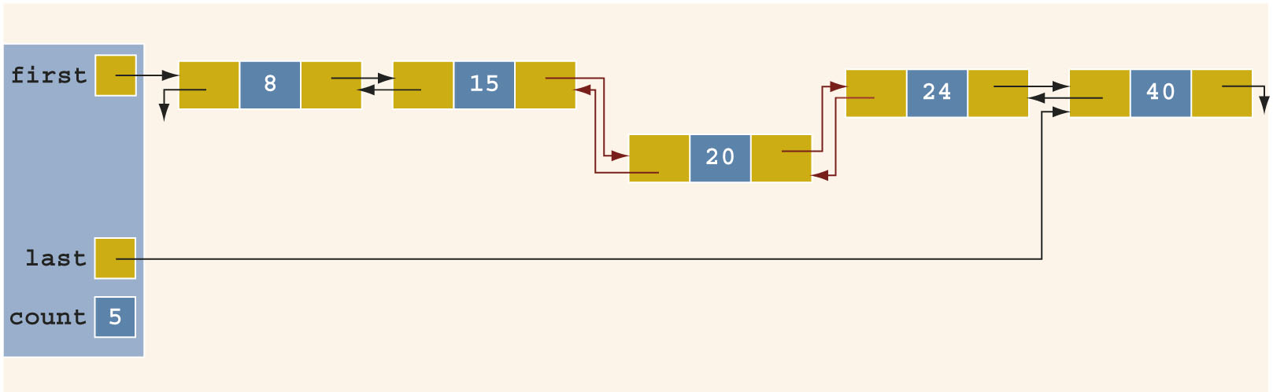
Insert a Node (2 of 2)
FIGURE 17-40 Doubly linked list before inserting 20
FIGURE 17-41 Doubly linked list after inserting 20

Slide 78
Delete a Node (1 of 3)
Case 1: The list is empty
Case 2: The item to be deleted is first node in list
Must update the pointer first
Case 3: Item to be deleted is somewhere in the list
Case 4: Item to be deleted is not in the list
After deleting a node, count is decremented by 1

Slide 79

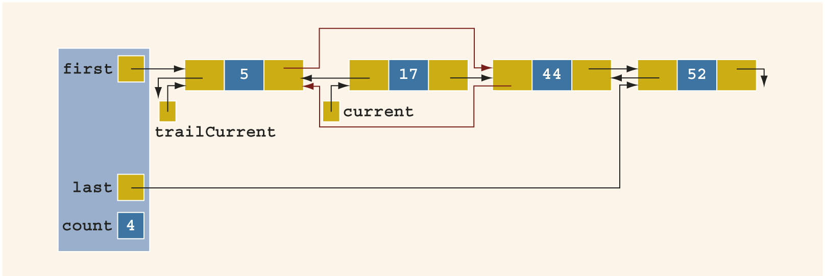
Delete a Node (2 of 3)
FIGURE 17-42 Doubly linked list before deleting 17
FIGURE 17-43 Doubly linked list after deleting 17

Slide 80
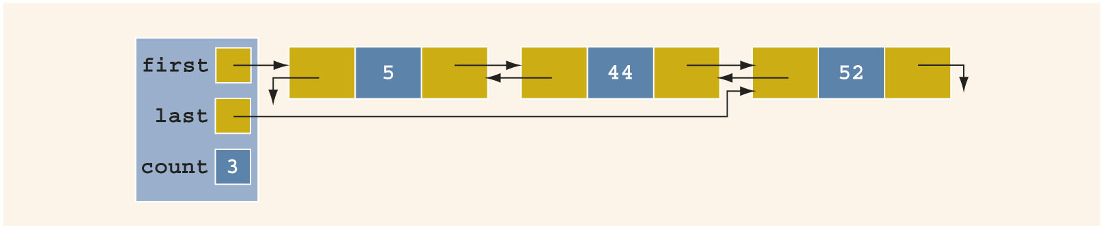
Delete a Node (3 of 3)
FIGURE 17-44 List after deleting the node with info 17

Slide 81
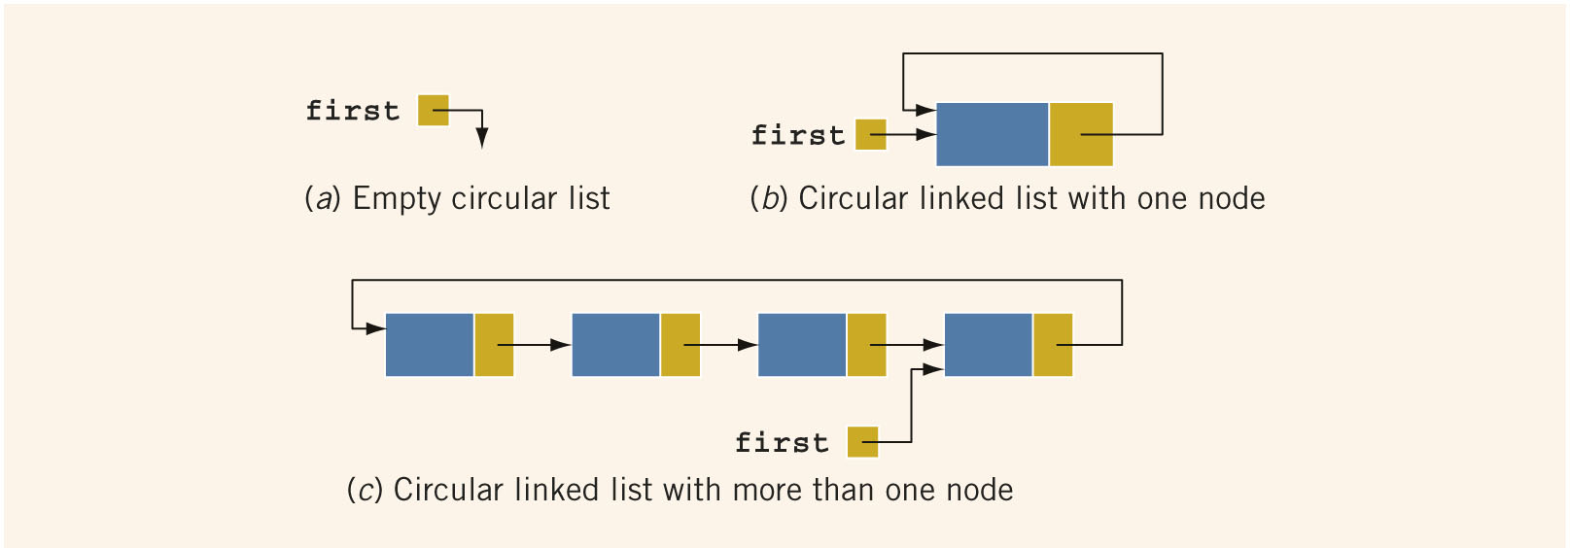
Circular Linked Lists (1 of 2)
Circular linked list: a linked list in which the last node points to the first node
FIGURE 17-45 Circular linked lists

Slide 82
Circular Linked Lists (2 of 2)
Operations on a circular list:
Initialize the list (to an empty state)
Determine if the list is empty
Destroy the list
Print the list
Find the length of the list
Search the list for a given item
Insert or delete an item
Copy the list

Slide 83
Summary (1 of 3)
A linked list is a list of items (nodes)
Order of the nodes is determined by the address (link) stored in each node
Pointer to a linked list is called head or first
A linked list is a dynamic data structure
The list length is the number of nodes

Slide 84
Summary (2 of 3)
Insertion and deletion does not require data movement
Only the pointers are adjusted
A (single) linked list is traversed in only one direction
Search of a linked list is sequential
The head pointer is fixed on first node
Traverse: use a pointer other than head

Slide 85
Summary (3 of 3)
Doubly linked list
Every node has two links: next and previous
Can be traversed in either direction
Item insertion and deletion require the adjustment of two pointers in a node
A linked list in which the last node points to the first node is called a circular linked list

